Slide 1
LLM-Based Image Caption Augmentation for Text-Guided Radiology Image Generation Using Diffusion Models with Pre-trained Encoders
Ahmed Abul Hasanaath
G202302610

Slide 2

Outline
Background
Approach
Results and Discussion
Limitations
Conclusion

Slide 3
Background

Slide 4
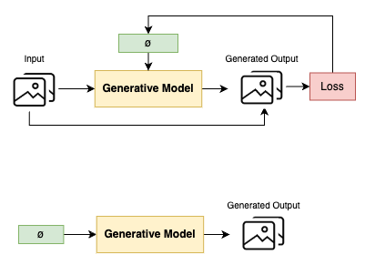
Training
Testing

Slide 5
Systematically and slowly destroy structure in a data distribution through an iterative forward diffusion process.
We then learn a reverse diffusion process that restores structure in data

Slide 6
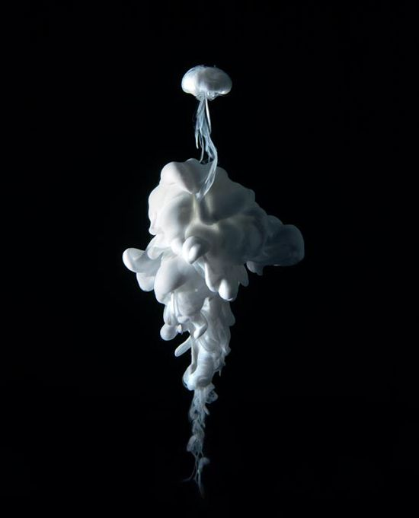

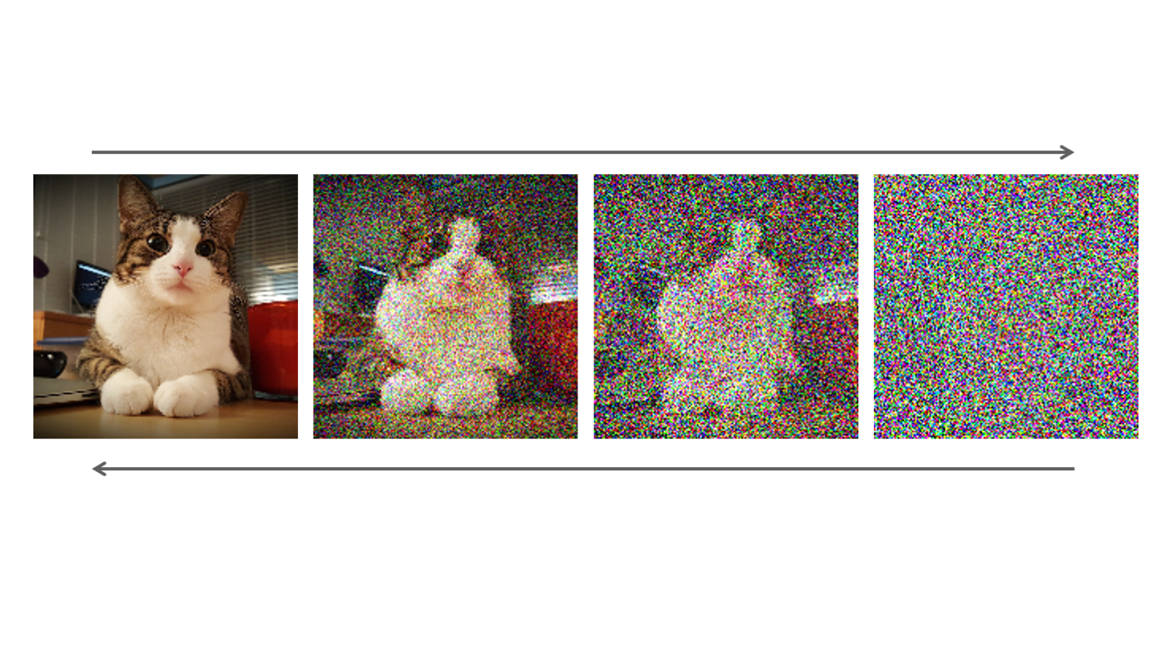
Forward Diffusion
Start off with original image and add noise to image over multiple steps until the image becomes pure noise
The noise is generally sampled from a normal distribution
Hint
Inspired by the field of thermodynamics and equilibrium

Slide 7
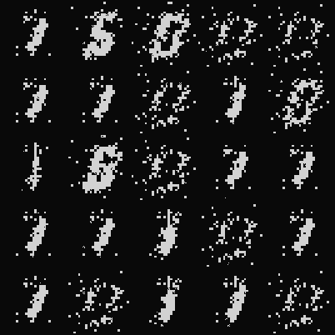
Reverse Diffusion
A neural network that learns to remove noise from an image step by step
Start off with noise sampled from normal distribution
Neural network basically predicts the noise of the image at each step and removes it from the image

Slide 8

Unet

Slide 9
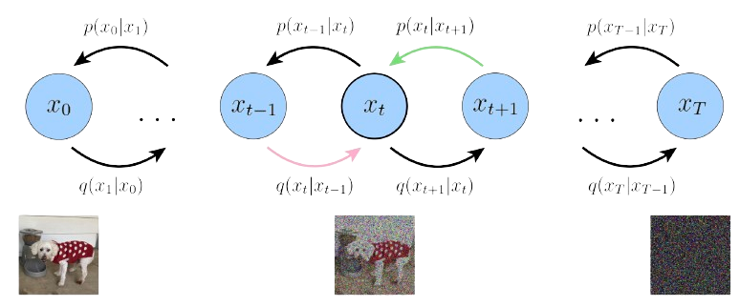
Complete Picture

Slide 10
Approach

Slide 11
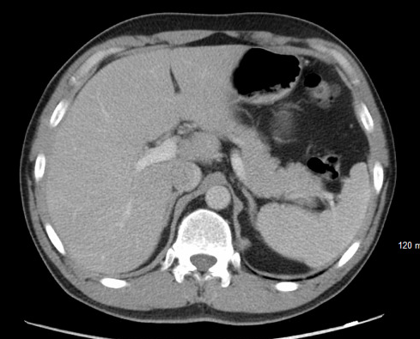
Dataset - ROCOv2
Images | CUI | Caption
 | C0040405 C0030797 C0001304 | Repeat CT abdomen and pelvis showing resolution of collection with no new abscess

Slide 12
Dataset Pre-processing

Slide 13
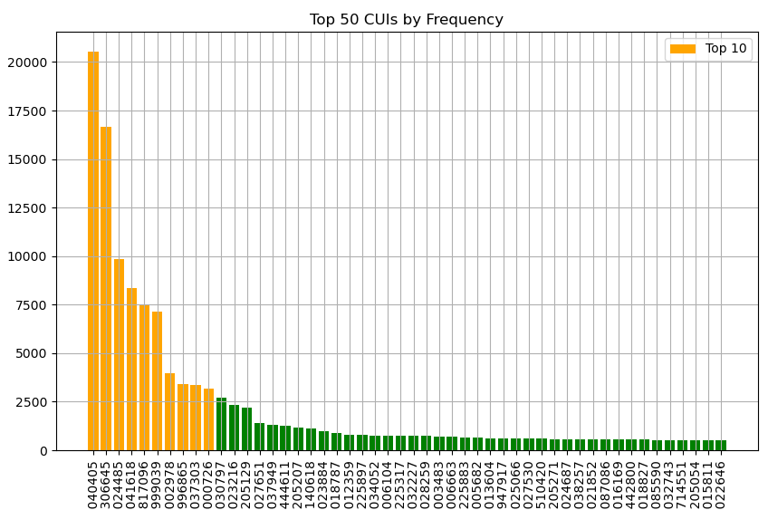
CUI Frequency
25th Percentile | 11
50th Percentile | 19
75th Percentile | 44
99th Percentile | 874

Slide 14
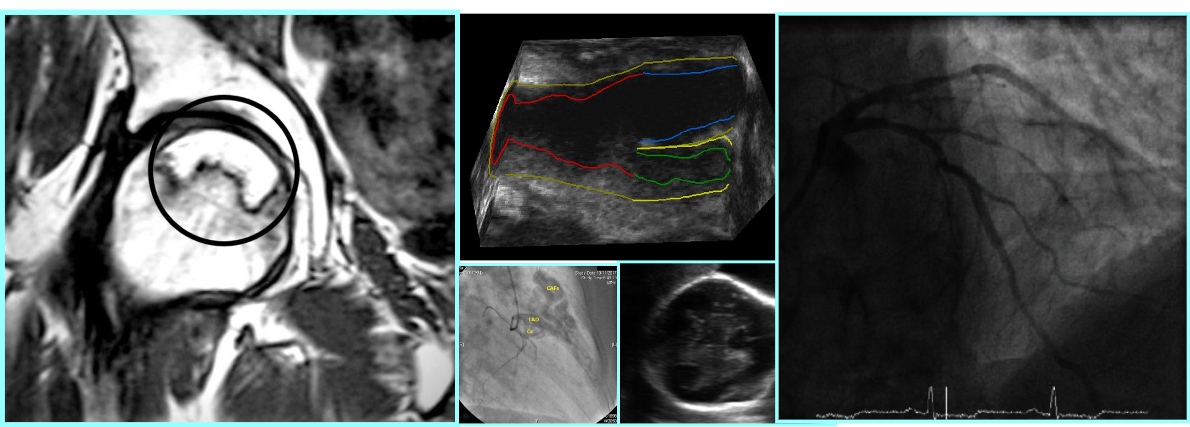
Dataset Pre-processing
Dataset Analysis and Representation
- Importance of dataset fully representing the domain.
- Analyzing data distribution to remove inadequately represented and noisy data.
CUIs (UMLS Concept Unique Identifiers)
Dataset contains images with corresponding CUIs.
1935 CUIs used to describe the images.
Distribution analysis of CUIs:
Figure illustrating the number of images described by top 50 CUIs.
Steep fall-off in the number of images after the first 10 CUIs.
99% of CUIs describe less than 874 images.
Decision to limit dataset to top 10 CUIs.
Image Quality Assessment
Filtering out low-quality images to avoid noise during training.
Quality assessed using entropy measure.

Slide 15
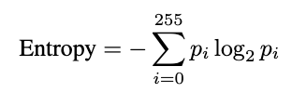
Dataset Pre-processing
Entropy Calculation Process
Entropy formula:
Entropy Interpretation
Measures uncertainty or disorder in pixel intensity distribution.
Higher entropy indicates greater complexity/variability.
Lower entropy suggests uniform/predictable distribution.
Ensures only meaningful intensity levels contribute to entropy calculation.
Assesses overall randomness and information richness in the image.
Outcome
Entropy helps in evaluating image quality.
Identifies and filters out noisy or low-quality images.

Slide 16
Caption Transformation

Slide 17
Caption Transformation
Dataset Captions:
Original image captions provided in the dataset.
Combined Captions:
Combination of the image caption and the corresponding CUI (Concept Unique Identifier) description from the dataset.
LLM Transformed Captions:
Large Language Model (LLM) used to rewrite the captions in a specific template designed to provide a structured and standardized format.
The Llama3 model was used for the caption transformation.
LLM Transformed Captions with Image Caption and CUI Description:
A simple concatenation of Transformed Captions, Image Caption and CUI Description.

Slide 18
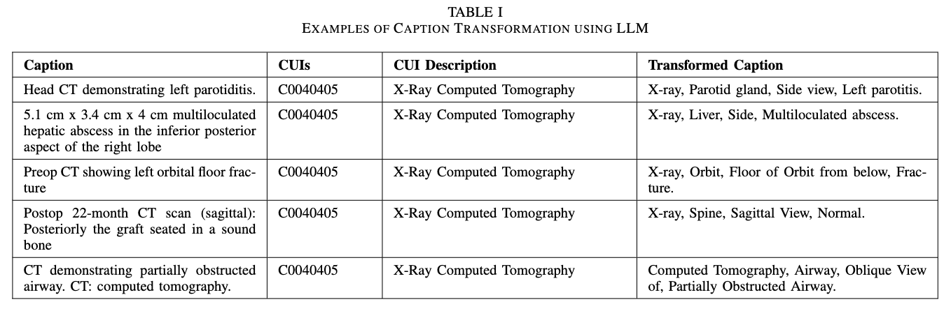
Examples

Slide 19
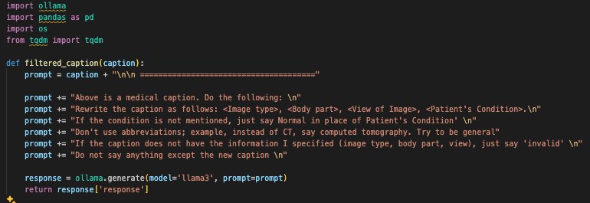
Caption Transformation

Slide 20
Model Architecture

Slide 21
Diffusion Model
Noise Schedule
Linear noise schedule controls noise addition.
Interpolation between:
Starting noise level ß = 1 x 10⁻⁴.
Ending noise level: ß = 0.02.
Fixed number of steps, typically 1000.
Smooth noise increase aids denoising learning.
Classifier-Free Guidance
Enhances image quality and text alignment.
Model trained with conditional (text) and unconditional (no text) data.
Inference generates two predictions:
Text-conditioned.
Unconditioned.
Adjusts weighting between predictions for better textual alignment.

Slide 22
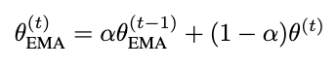
Diffusion Model
Exponential Moving Average (EMA)
Stabilizes training and improves robustness.
Maintains a moving average of model weights.
Update formula:
Decay rate ∂ close to 1 (commonly 0.999 or higher).
EMA parameters typically yield more stable and reliable performance.
Sampling Process
Starts with random noise image.
Iteratively refined using trained UNet model.
Model predicts and subtracts noise at each timestep.
Continues until final image is generated.
Classifier-free guidance and EMA ensure high-quality, text-aligned images.

Slide 23
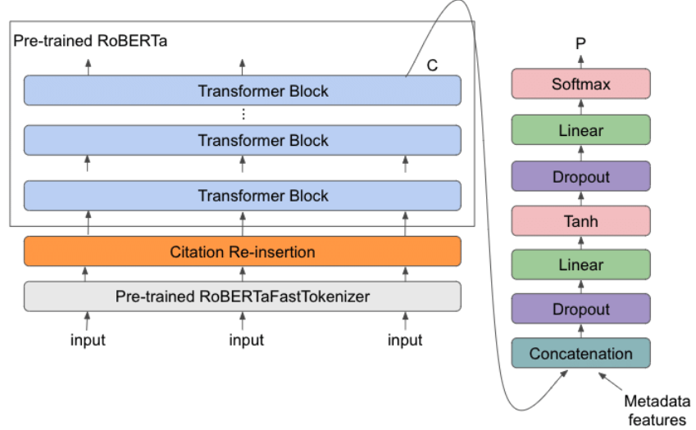
RadBERT

Slide 24
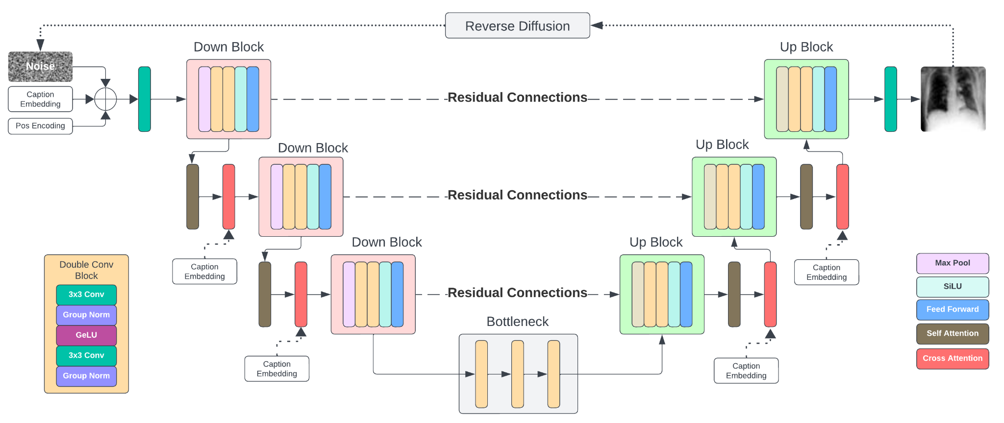
Unet

Slide 25
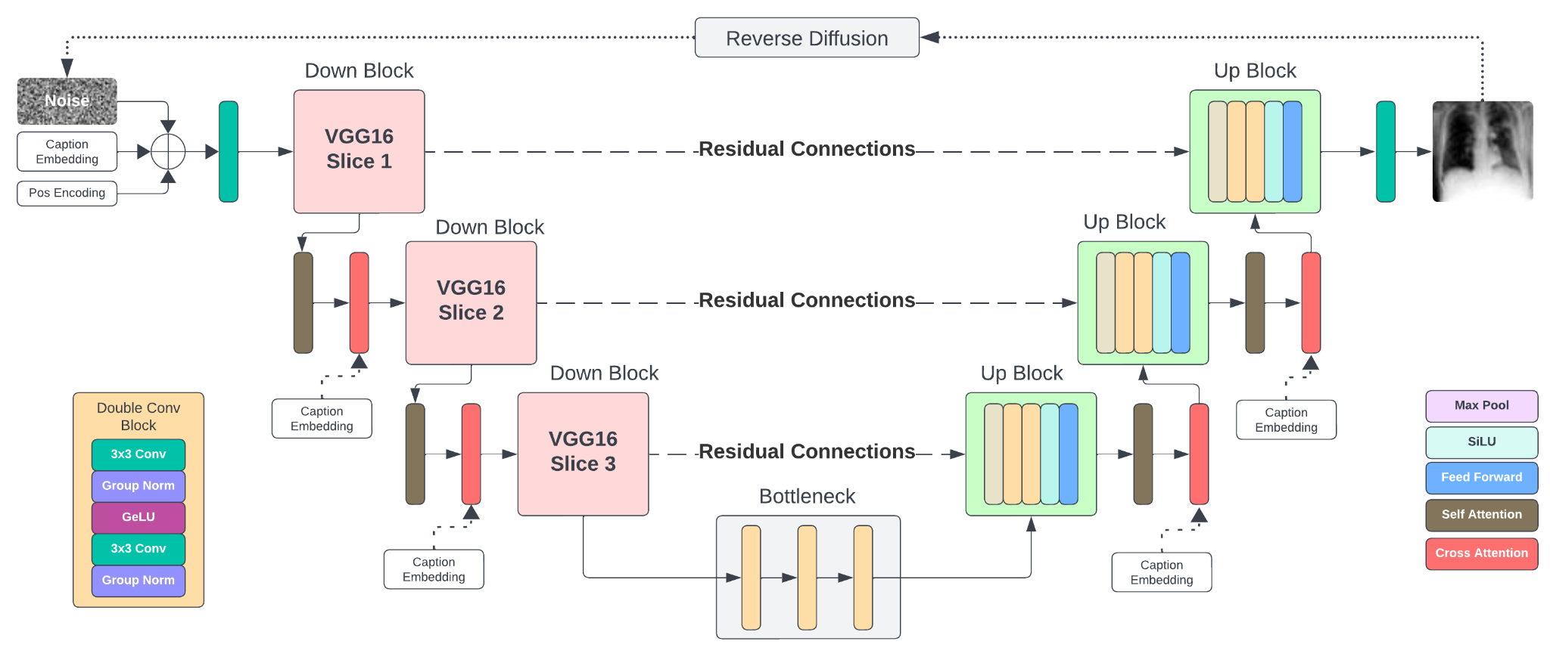
VGG Unet

Slide 26
VGG Unet
Slice 1 Sequential(
(0): Conv2d(3, 64, kernel_size=(3, 3), stride=(1, 1), padding=(1, 1))
(1): ReLU(inplace=True)
(2): Conv2d(64, 64, kernel_size=(3, 3), stride=(1, 1), padding=(1, 1))
(3): ReLU(inplace=True)
)
Slice 2 Sequential(
(4): MaxPool2d(kernel_size=2, stride=2, padding=0, dilation=1, ceil_mode=False)
(5): Conv2d(64, 128, kernel_size=(3, 3), stride=(1, 1), padding=(1, 1))
(6): ReLU(inplace=True)
(7): Conv2d(128, 128, kernel_size=(3, 3), stride=(1, 1), padding=(1, 1))
(8): ReLU(inplace=True)
)

Slide 27
VGG Unet
Slice 3 Sequential(
(9): MaxPool2d(kernel_size=2, stride=2, padding=0, dilation=1, ceil_mode=False)
(10): Conv2d(128, 256, kernel_size=(3, 3), stride=(1, 1), padding=(1, 1))
(11): ReLU(inplace=True)
(12): Conv2d(256, 256, kernel_size=(3, 3), stride=(1, 1), padding=(1, 1))
(13): ReLU(inplace=True)
(14): Conv2d(256, 256, kernel_size=(3, 3), stride=(1, 1), padding=(1, 1))
(15): ReLU(inplace=True)
)

Slide 28
Results

Slide 29
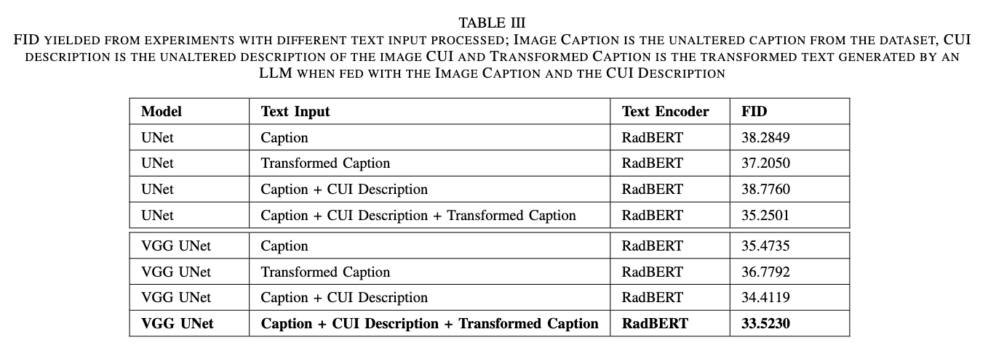
Results

Slide 30
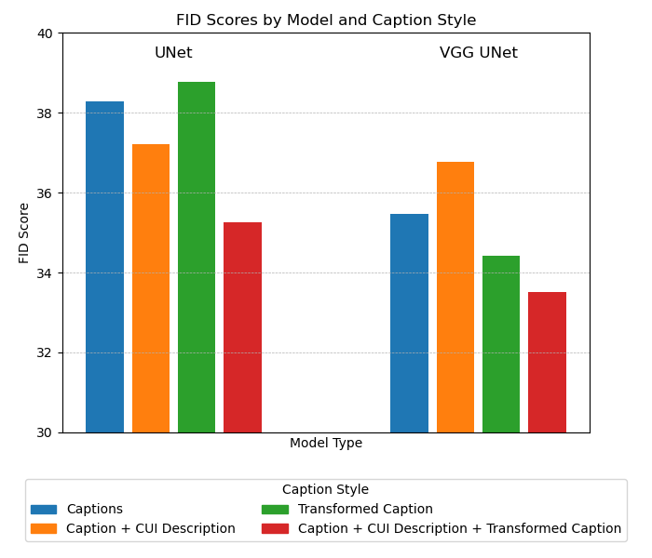
Results

Slide 31
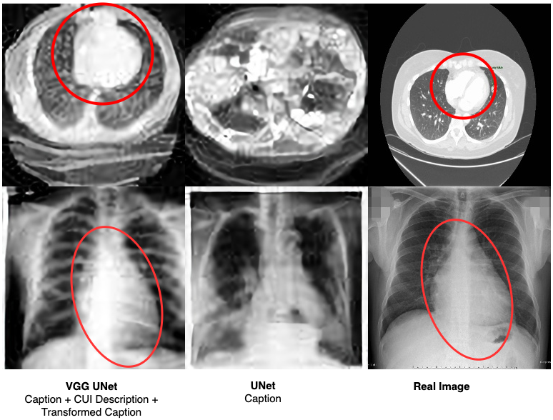
Results

Slide 32
Limitations

Slide 33
Limitations
Hardware Constraints
VRAM capacity of NVIDIA A5000 GPU: 24GB.
Significant impact on experimental setup and model training.
Image Resolution Limitations
Small image size: 64x64 pixels.
Larger sizes caused out-of-memory errors.
Reduced resolution likely affected model performance.
Model Architecture Limitations
Unable to experiment with SOTA diffusion models.
High computational demand led to memory issues.
No direct comparison with advanced generative models.

Slide 34
Limitations
Text Encoding Challenges
Planned to use CLIP for robust multimodal data understanding.
VRAM limitations required drastically reduced batch sizes.
Prevented comparison with the RadBERT encoder.
Advanced Textual Integration Issues
Integration of image captions, CUI descriptions, and transformed captions using an attention module was planned.
High memory requirements led to VRAM exhaustion.
Inability to use advanced textual integration limited potential generative quality improvements.
Dataset Challenges
Significant amount of noisy and non-descriptive images despite filtering.
Frequent occurrence of low-quality images in the dataset.
Noisy images impacted training of the diffusion model.

Slide 35
That’s it! Any Questions?

